Slide 1
Object Oriented Programming Lab CSE 1206
LAB 6

Slide 2
Remember the inheritance example?
Shape | -color -filled -calculateArea()
Circle | -radius -calculateArea()
Rectangle | -length -width -calculateArea()
Square

Slide 3
Previous Codes:
Shape Class’s Code: https://paste.ubuntu.com/p/jMpNRPFcQg/
Circle Class’s Code:
https://paste.ubuntu.com/p/KSrj7n3YXY/
Rectangle Class’s Code:
https://paste.ubuntu.com/p/QzybQfddNn/
Square Class’s Code:
https://paste.ubuntu.com/p/ZXVtqqrwzd/

Slide 4
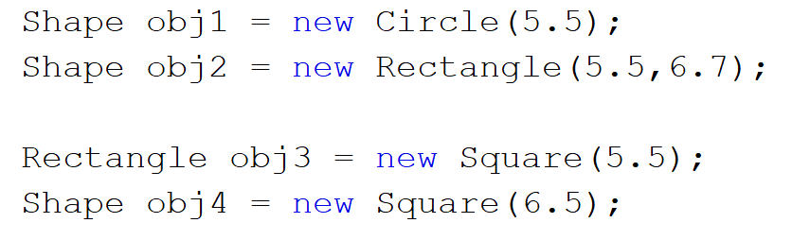
A superclass reference variable can refer to a subclass object.
This is also known as upcasting. Java uses this fact to resolve calls to overridden methods at run time.

Slide 5
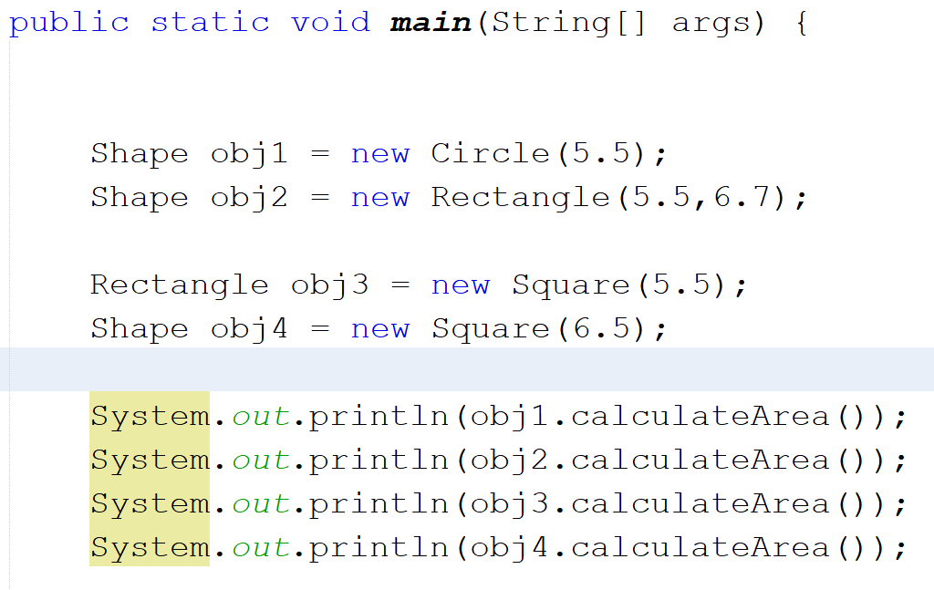

Slide 6
Dynamic Method Dispatch
This upcasting is used to call overridden methods.
The super class variable will only recognize the overridden methods.
When an overridden method is called through a superclass reference, Java determines which version(superclass/subclasses) of that method is to be executed based upon the type of the object being referred to at the time the call occurs.
Thus, this determination is made at run time.

Slide 7
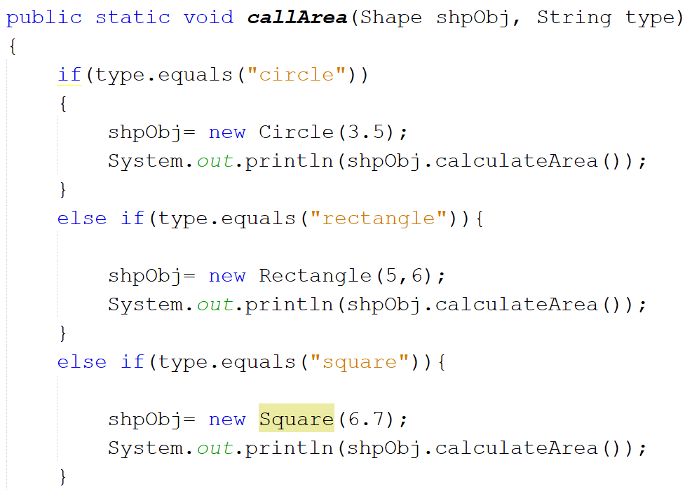
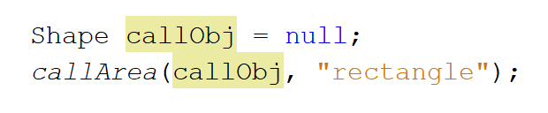
Example
https://paste.ubuntu.com/p/JHb2kjzrY3/
Notes:
https://paste.ubuntu.com/p/JHb2kjzrY3/

Slide 8
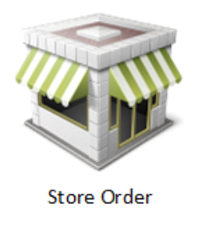
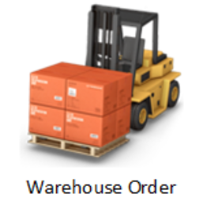
Company Sales Software for different types of Orders
Factory Order
Process the order
Validate the order
Cancel the order

Slide 9
You will need an employee to process the order. So there will be an employee class
Employee
empID;
name;
designation;
An order will be created against a product. So there will be a product class:
Product
productID;
productType;
productName;

Slide 10
Create a project and create the Product, Employee and Order class.
Product Class
https://paste.ubuntu.com/p/SpSdvcTB5b/
Employee Class
https://paste.ubuntu.com/p/SYRn6G2cC8/
Order Class
https://paste.ubuntu.com/p/TNk8wXsHv6/

Slide 11



What if more order types are created?
Factory Order
Facebook Order
Instagram Order

Slide 12
Solution: Create separate classes for each order type but each class must be forced to implement the methods process() and validate() This can be done using Abstract

Slide 13
Abstract Class

Slide 14
A class which contains the abstract keyword in its declaration is known as abstract class.
Abstract classes may or may not contain abstract methods, i.e., methods without body ( public void get(); )
But, if a class has at least one abstract method, then the class must be declared abstract.
If a class is declared abstract, it cannot be instantiated.
To use an abstract class, you have to inherit it in another class and provide implementations to all the abstract methods in it.

Slide 15
Rules:
If you declare variables in abstract class then they must be initialized using a parameterized constructor.
The parameterized constructor must be called in the sub class using super();
An abstract class cannot be initialized with its own constructor. You will need to use the sub class constructor to do so.

Slide 16
An Example of how to make and use abstract class

Slide 17
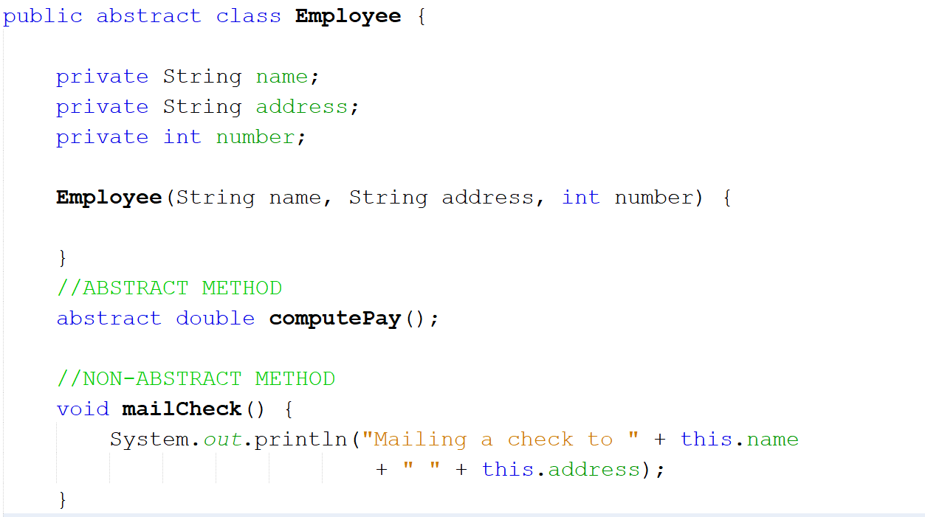
Abstract Method has no body

Slide 18
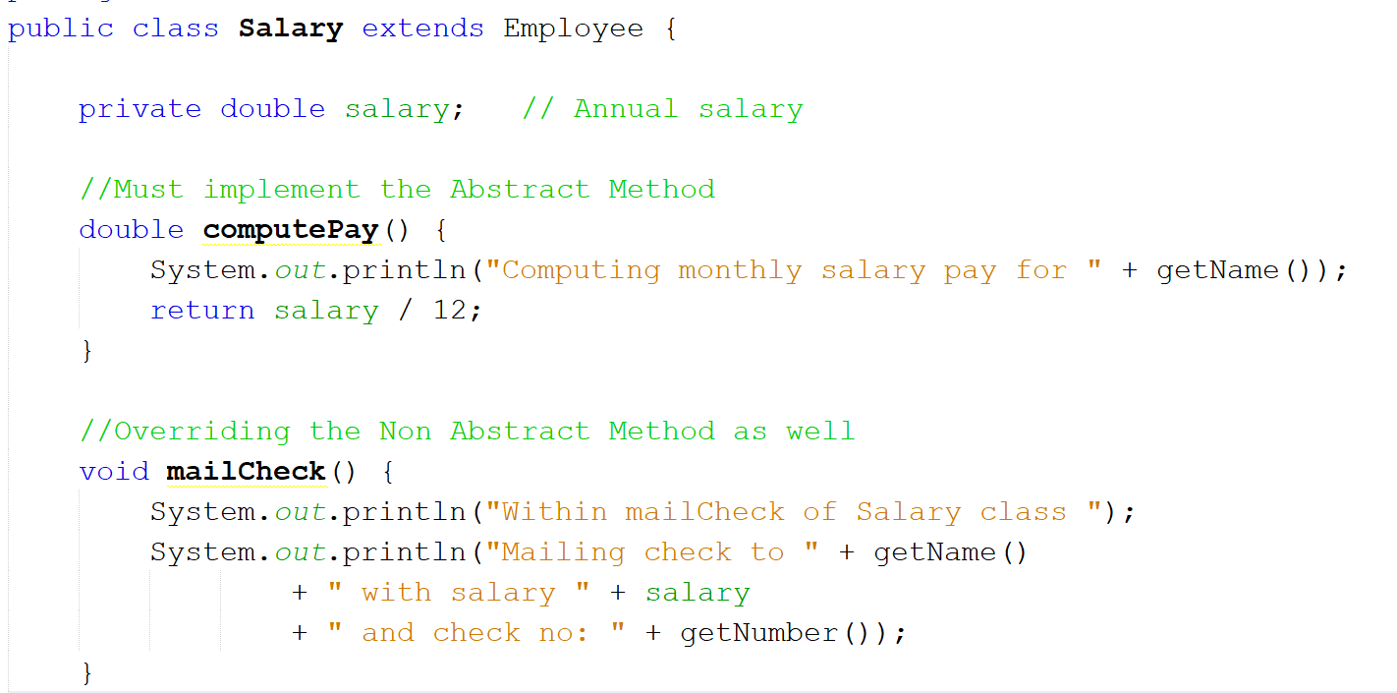

Slide 19
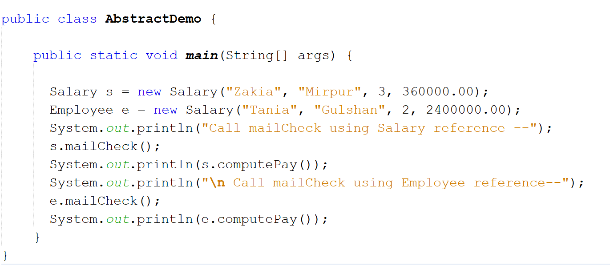

Slide 20
Now Declare the two methods abstract in Order class
public abstract void validate();
public abstract void process() ;
Create two separate class for Store and Factory Orders and design the code accordingly.

